Slide 1
Novices and Formative Assessment
Notes:
We’ll now get started with our first round of learning some theory, how it relates to Software and Data Carpentry, and putting that theory into practice.

Slide 2
Cognitive Development and Mental Models
What is a mental model?
Notes:
Effective learning happens when a learner creates a mental model of the domain
Ball and stick model used in chemistry (Aminoethylpiperazine)
- Radius of spheres much smaller than rod lengths (space not representative!)
- Colours are used to show atomic types
Our goal is help them build a working mental model of something
But we have to first characterise the skill level of someone to know how best to teach them
to develop or improve their mental model

Slide 3
How to Characterise Skill?
Differences in skill – mental model ‘big picture’
Dreyfus model of skill acquisition simplified:
Novice
Competent Practitioner
Expert
Doesn’t know what they don’t know – no mental model of domain
Reason by analogy and guesswork
Borrow from other mental models that seem similar
Good mental model for everyday purposes, e.g. driver and car
Model perhaps not completely accurate
Can do normal tasks with normal effort under normal circumstances
Can handle out of the ordinary situations
Diagnose problem causes
Notes:
Novice: haven't worked out the key ideas or how they relate
Dreyfus: Patricia Benner, who applied the Dreyfus model of skill acquisition in her studies of how nurses progress from novice to expert
Important that each type is taught differently

Slide 4
Tutorial vs Manual
Novices, competent practitioners, experts need to be taught differently
vs
Reference Manual
Tutorial

Slide 5
Tutorial vs Manual
Tutorial
Linear
Examples
Limited in detail
Step by step
Focused on a specific task
Assumes no prior knowledge
Narrative
Novice - PROCESS
Manual
Complete in detail
Factual
Troubleshooting
To get specific information
Flat representation of importance of material
Consistent, minimal style
COVER FACTS
Notes:
How would you characterise tutorials and manuals?
What are the characteristics of each?
Tutorials good for beginners – contains facts and relationships, can build a mental model (manuals don’t explain things)
Manuals good for practitioners and experts – already have mental model to attach facts to (tutorials can be too slow)
Tutorials:
Numbered bullet points
Very specific for specific tasks
Example-based
Step by step – process
Motivational
Instructive
Fun
Acquiring skill
COVERS PROCESS
Manual:
Organised into specific sections
Very comprehensive
Descriptive
Boring
Dense
Problem solving focus
COVERS FACTS
Q: Why is a reference manual not a good tool for a novice?
A:One reason - It doesn’t help them understand how something works.

Slide 6
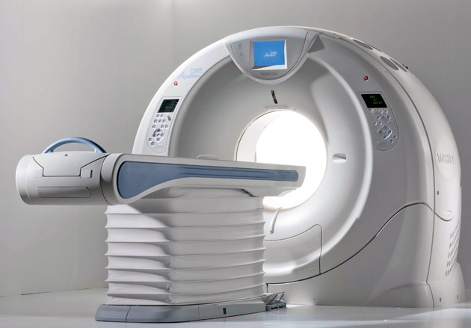
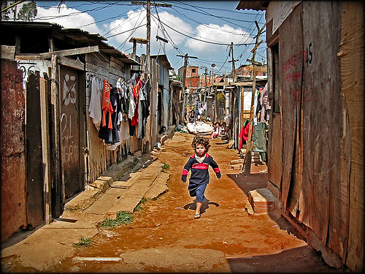
Assume Carpentry learners are Novices
5-15% use GPU clusters
to analyze petabytes
in the cloud
85-95% send each
other spreadsheets
by email
Easy to overload novices with too many facts
Unix shell lesson – 15 commands in 3 hours!
Help them develop a working mental model
Notes:
The RHS is simply the reality for perhaps the majority of our learners in a workshop
- Depends on discipline
Teaching unix shell – seems glacially slow to an expert
- goal isn’t to teach specific commands
- it’s to help learners construct the mental model that these commands fit into
- there’s so much more than just the commands they are learning
That model includes things like:
- Anything you repeat manually, you’ll eventually get wrong (so let the computer repeat things for you by using tab completion and the history command)
- Lots of little tools, combined as needed, are more productive than a handful of “kitchen sink” programs. (This motivates the pipe-and-filter model.)

Slide 7
Building Useful Mental Models
“It ain’t what you don’t know that gets you into trouble, it’s what you know for sure that just ain’t so” – Mark Twain
Clearing up learners misconceptions
Simple factual errors – easy to correct, but not enough
Broken models – correct by reasoning, address contradictions
Fundamental beliefs – e.g. “world is only a few thousand years old”, can’t really address these
Our focus!
Notes:
Help them to build models, but also to help correct them when they’re incorrect

Slide 8
What happens next?
Example of correcting a broken mental model
Place block of ice in a bathtub, fill tub to brim with water
When ice melts, does the water level:
Go up (overflowing the tub)
Go down
Stay the same?
Notes:
Floating object displaces amount of water equal to its own weight
Melted ice has same weight, so level doesn’t change.
Reasoning about right answer helps people build model of relationship between weight, volume and density

Slide 9
Assessing Mental Models
Need to expose the broken mental models
Our focus!
Summative Assessment
Formative Assessment
Did desired learning take place?
Can learner move on?
Pass or fail
Guide learning by informing instructor
and learner what to focus on
No pass or fail
Notes:
Need to find out how and where they are broken
Through assessment

Slide 10
Multiple Choice Questions
Formative assessment needs to be quick to administer and evaluate – e.g. MCQs
Q: what is 27 + 15?
42
32
312
33
Throwing away carry completely
Carried ‘1’ is actually a ten to be added
Carrying ‘1’ by adding to wrong column
Notes:
Each incorrect answer is a plausible distractor with diagnostic power
- “Plausible” means that it looks like it could be right
- We can each of use these to diagnose and correct a misconception

Slide 11
Applying MCQs
Teach some stuff
Present MCQ probing for misconceptions
Students vote on MCQ answers
Mostly all right answers, move on
Mostly all same wrong answer, address misconception
Mix of right and wrong, rewind to previous point, or get them to discuss
Recommend every 15 mins or so – break up session
Can use preemptively!

Slide 12
Exercise
Create multiple choice question related to topic you intend to teach
Explain diagnostic power of each distractor, i.e. what misconception is each distractor meant to identify? A sentence for each is fine
Pair up with your neighbor and discuss your MCQs, providing feedback
Place answers in Etherpad:
http://bit.ly/ITMet2016
Notes:
Green and red sticky notes
20 mins

Slide 13
Notes on MCQs
A good MCQ tests for conceptual misunderstanding, not facts
For distractors, think about problems from previous training events
MCQs are useful even if not used!

